Slide 1
BLOCKCHAIN DEMYSTIFIED
Clint Edmonson
Polaris Solutions
clinted@polarissolutions.com

Slide 2
WHAT IS BLOCKCHAIN?

Slide 3
THE NEXT BIG INTERNET BOOM?

Slide 4
A REPLACEMENT CURRENCY THAT WILL TAKE OVER THE WORLD?

Slide 5
A COMPUTER SCIENCE SOLUTION LOOKING FOR A PROBLEM?

Slide 6
A PRACTICAL SOLUTION TO REAL WORLD PROBLEMS?

Slide 7
LET’S FIGURE THIS OUT…

Slide 8
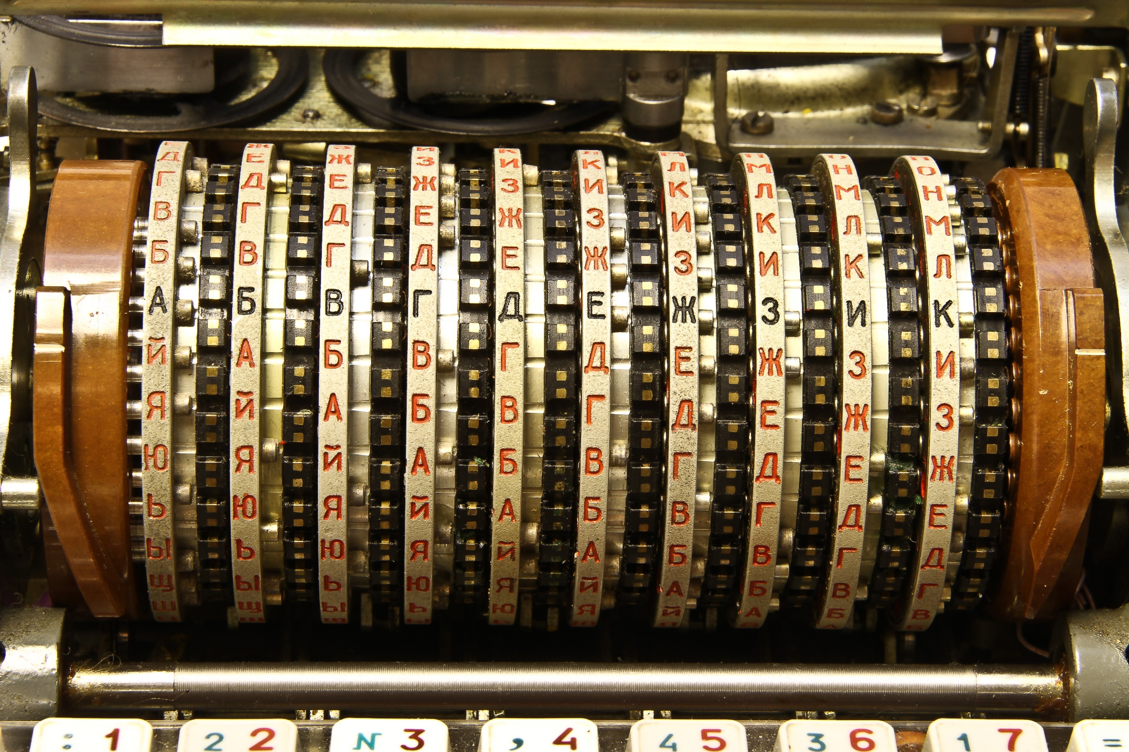
START WITH HASHING…

Slide 9
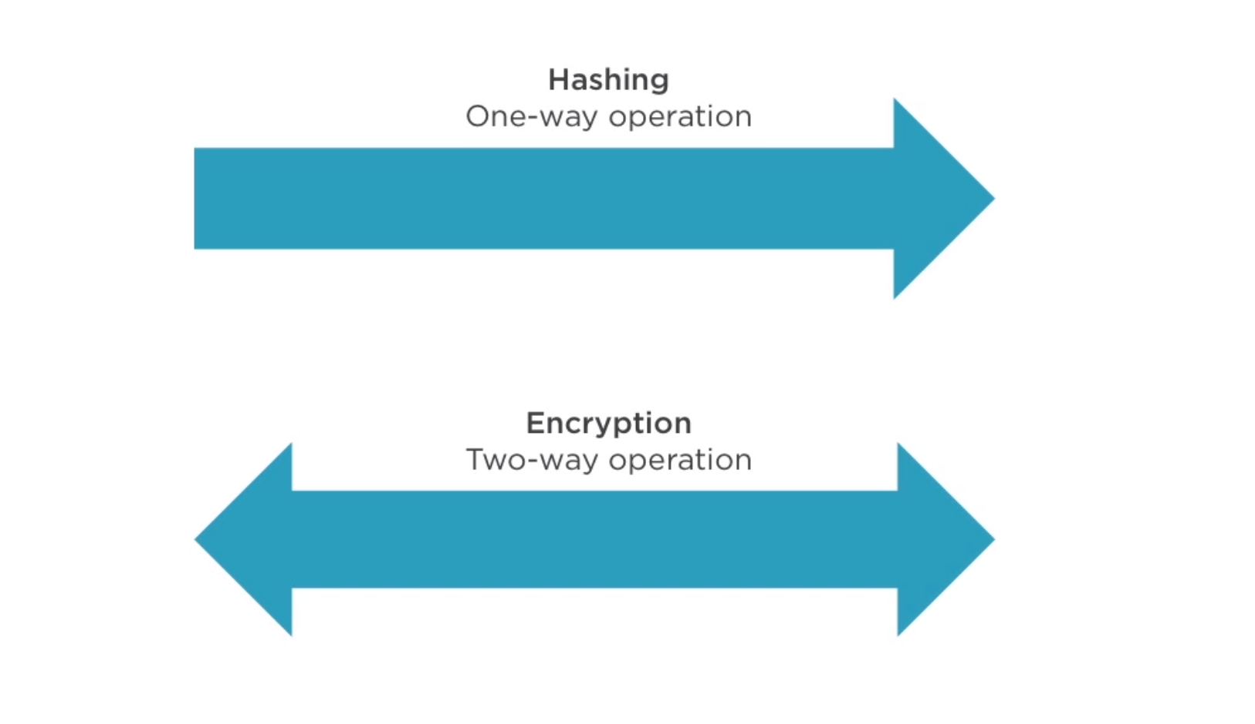

Slide 10
DEMO: SIMPLE HASHING

Slide 11
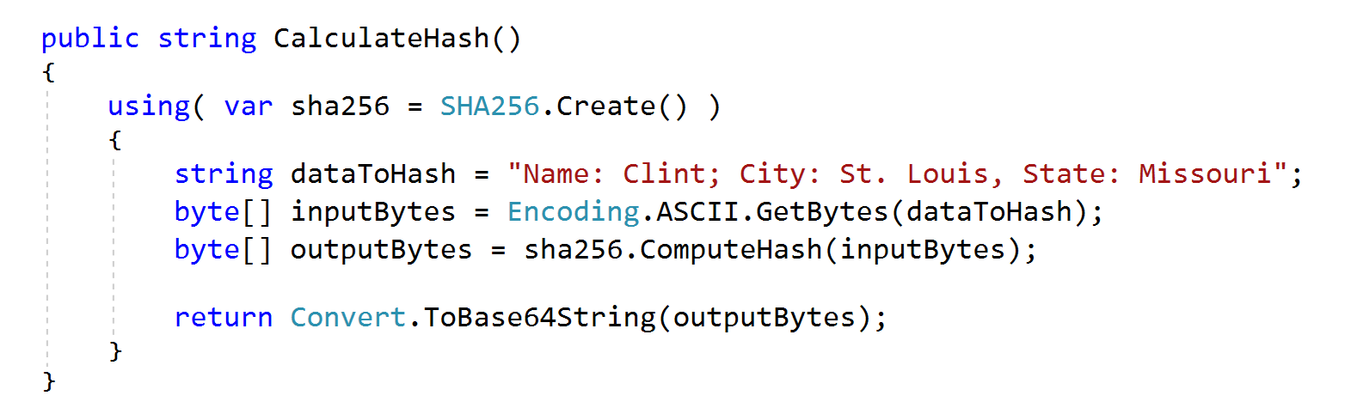
THE CODE

Slide 12
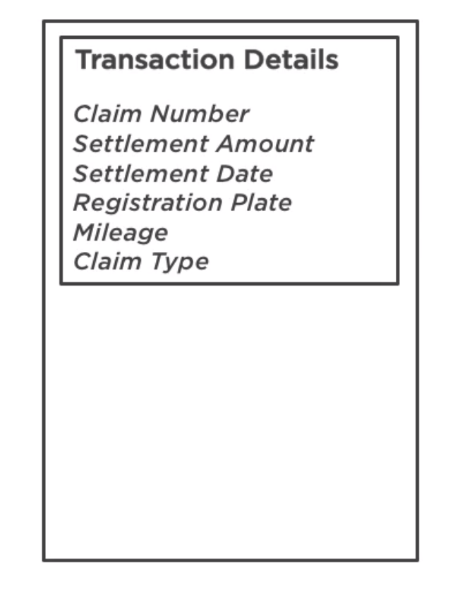
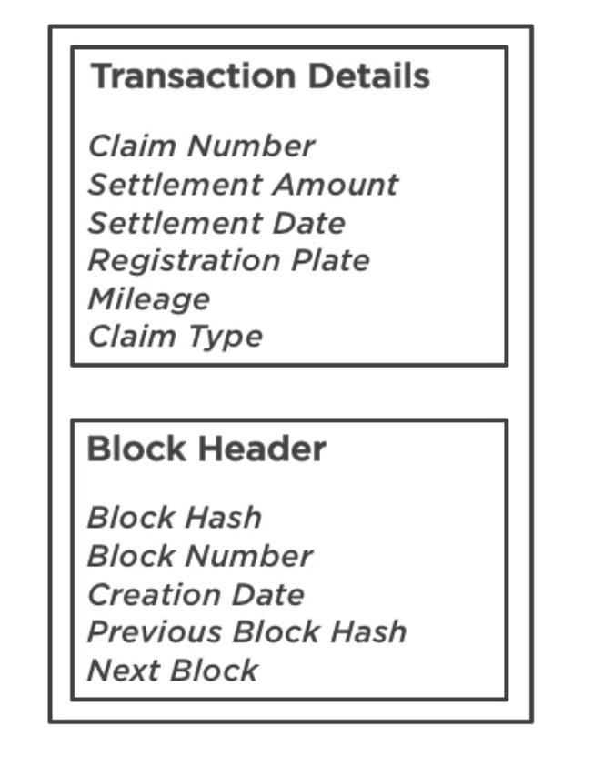
WHAT IS A BLOCK?

Slide 13
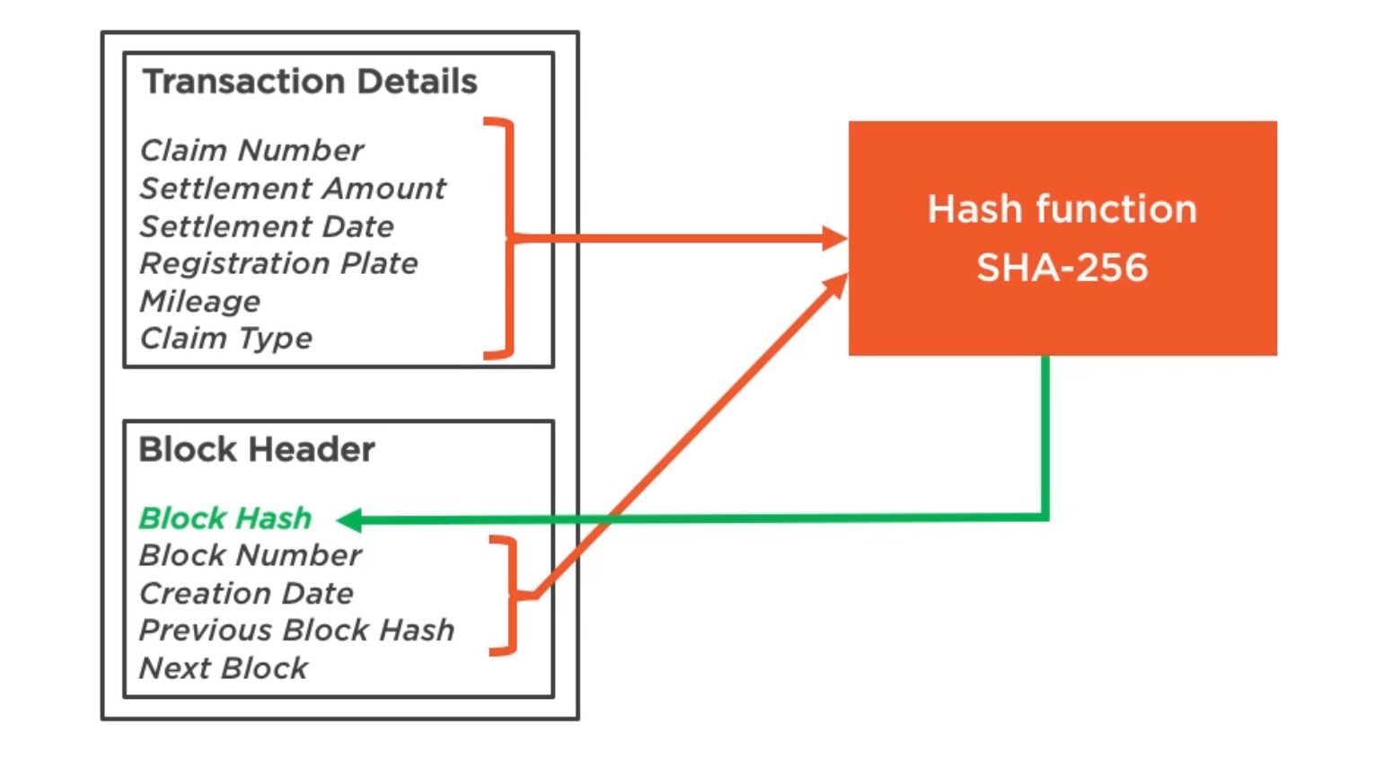

Slide 14
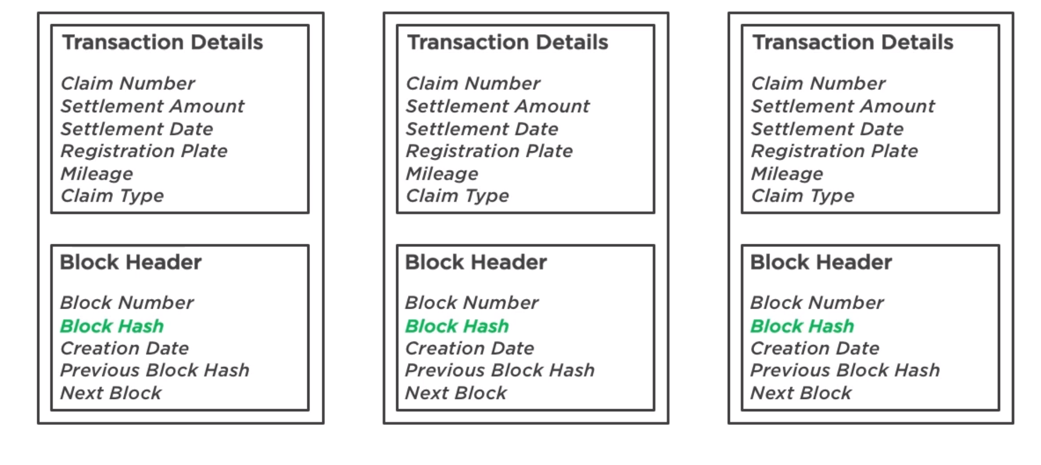

Slide 15
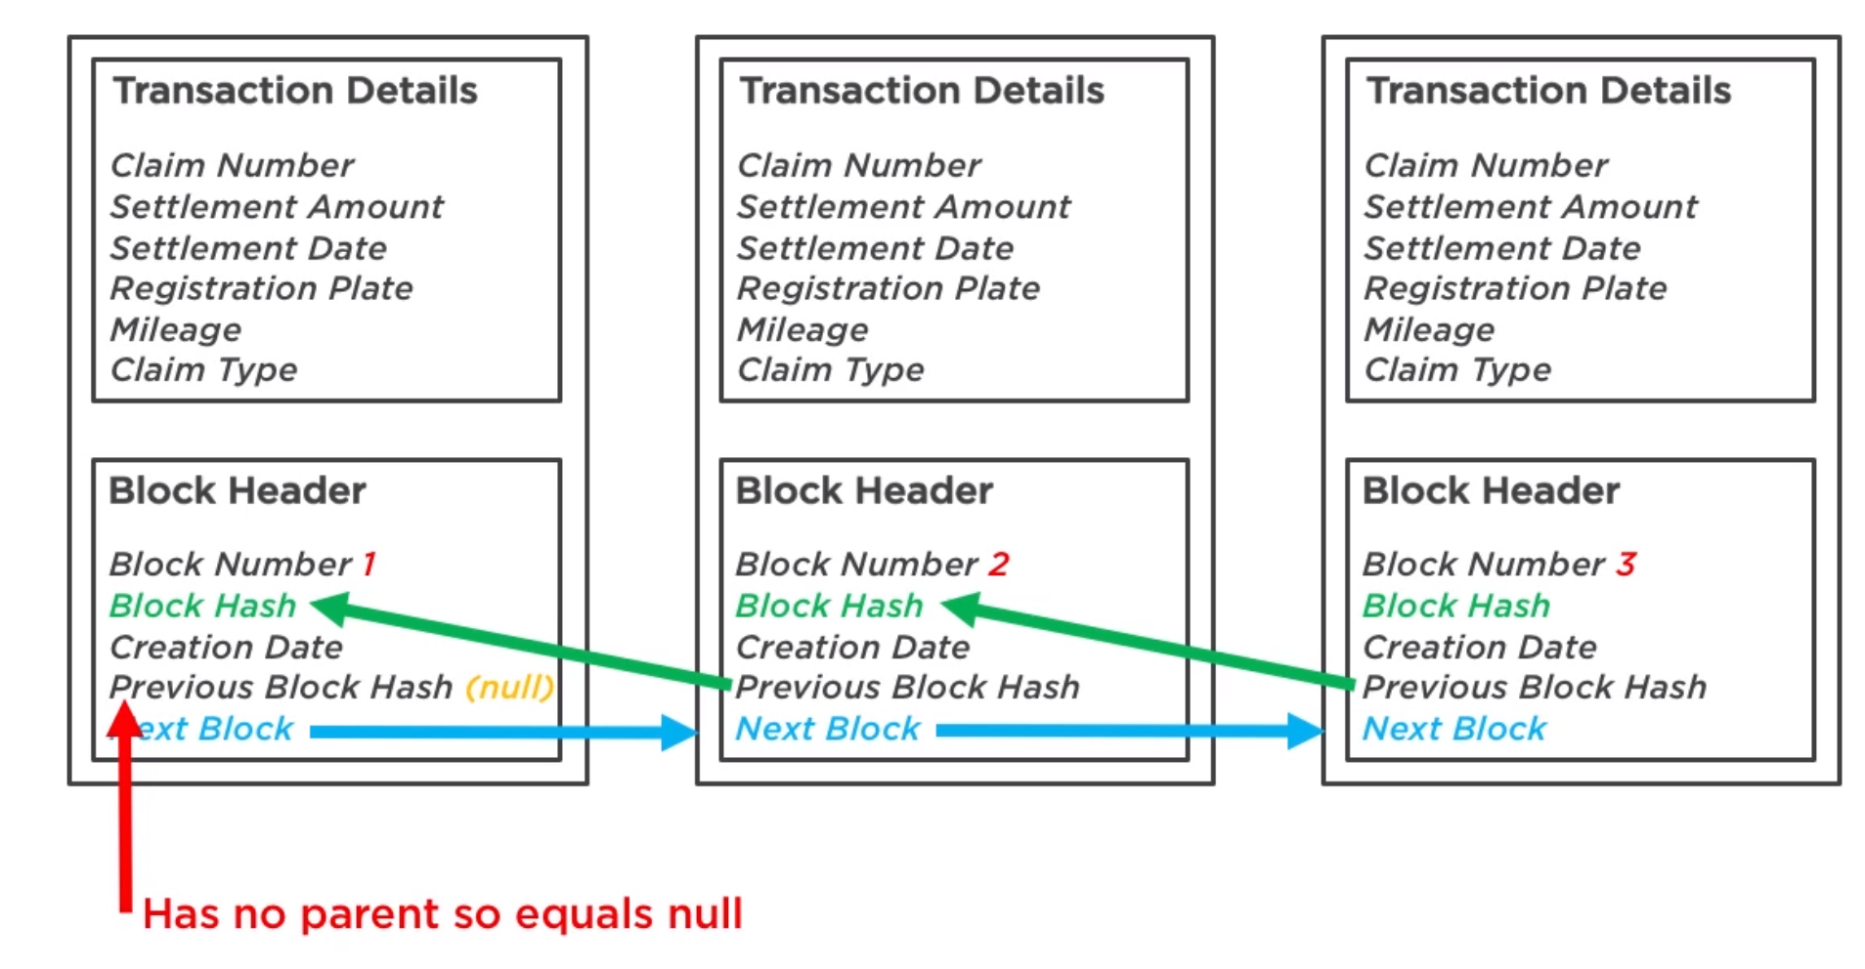

Slide 16
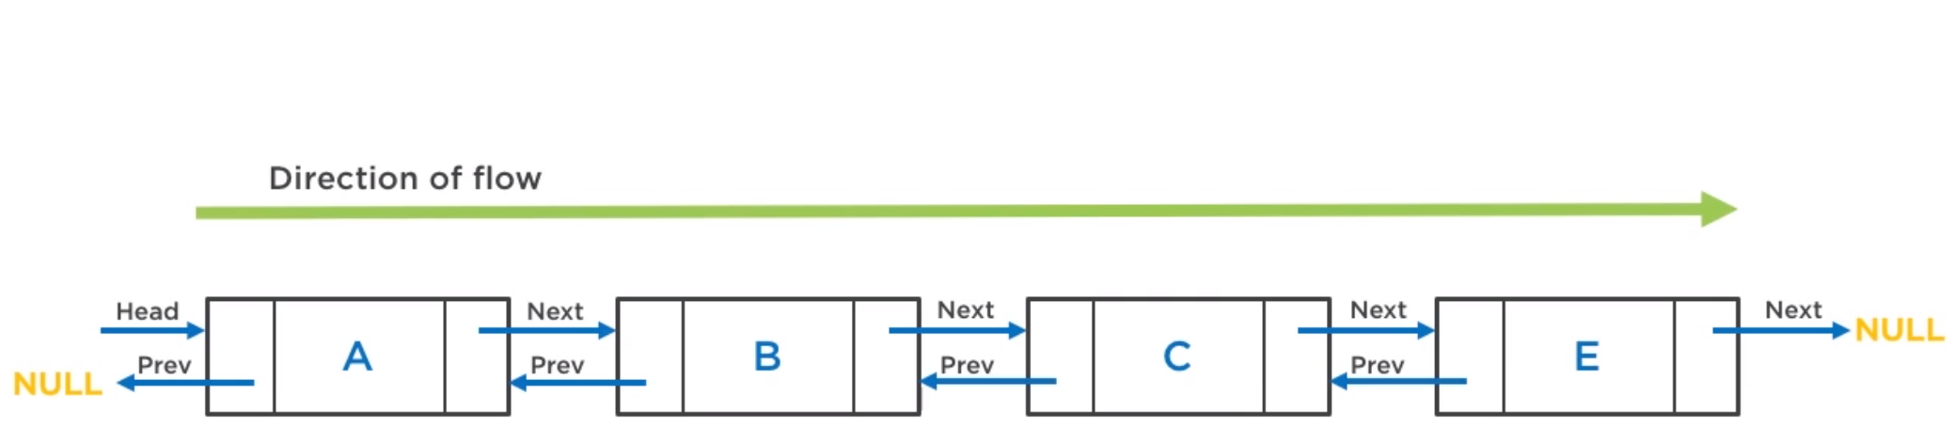
ROOTED, UNIDIRECTIONAL DOUBLY LINKED LIST

Slide 17
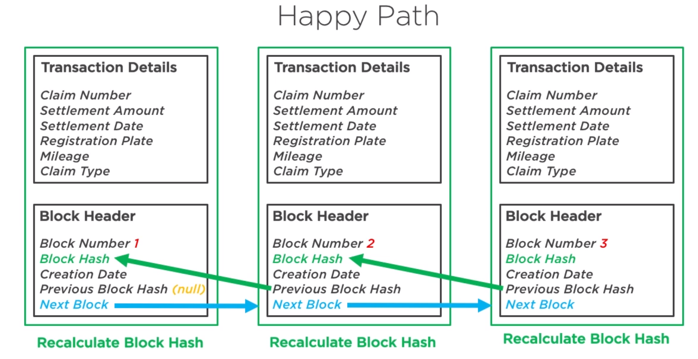

Slide 18
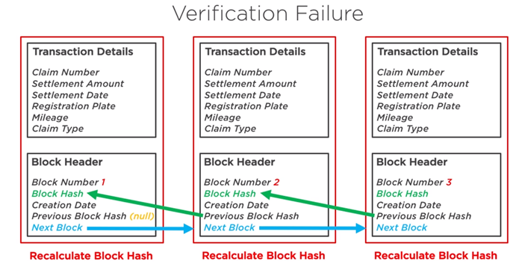

Slide 19
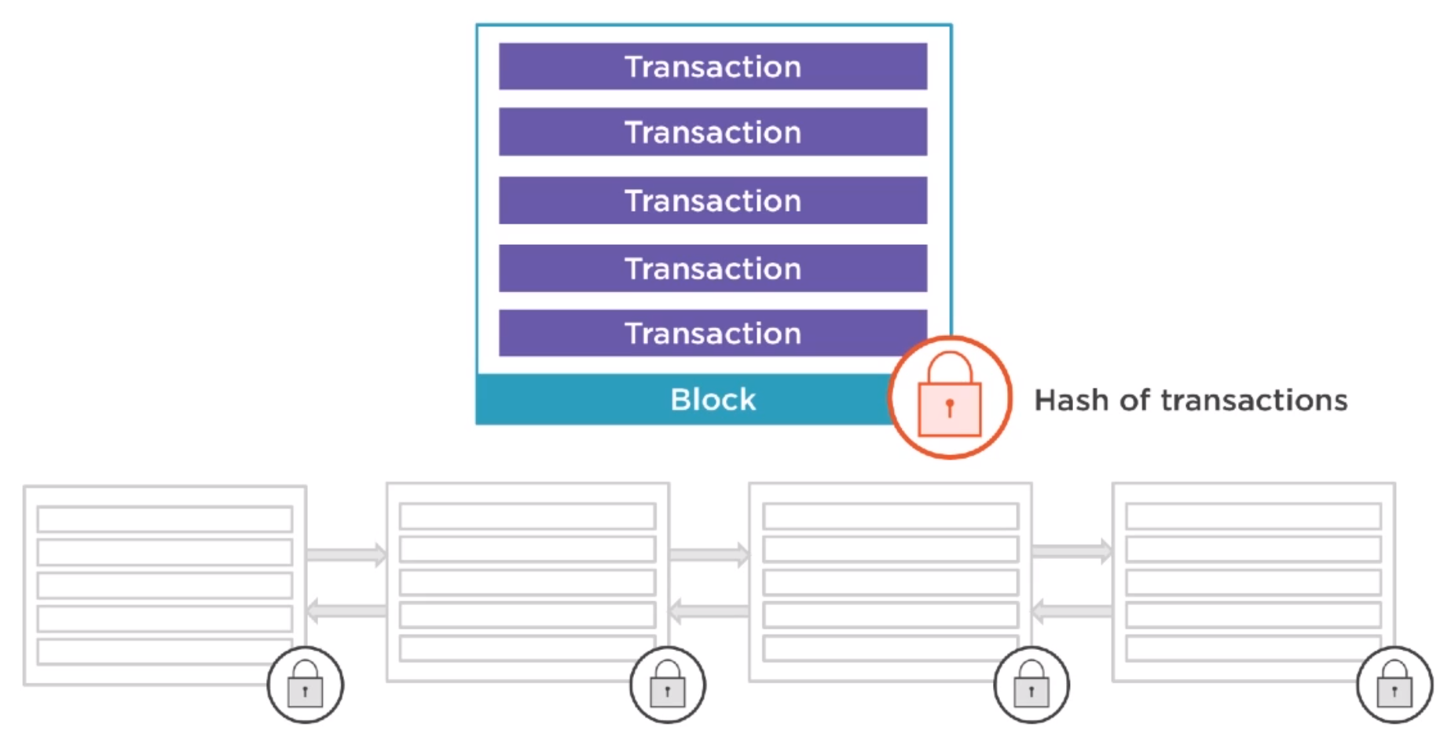

Slide 20
DEMO: SIMPLE BLOCKCHAINS

Slide 21
HOW DO WE SHARE THIS DATA?

Slide 22
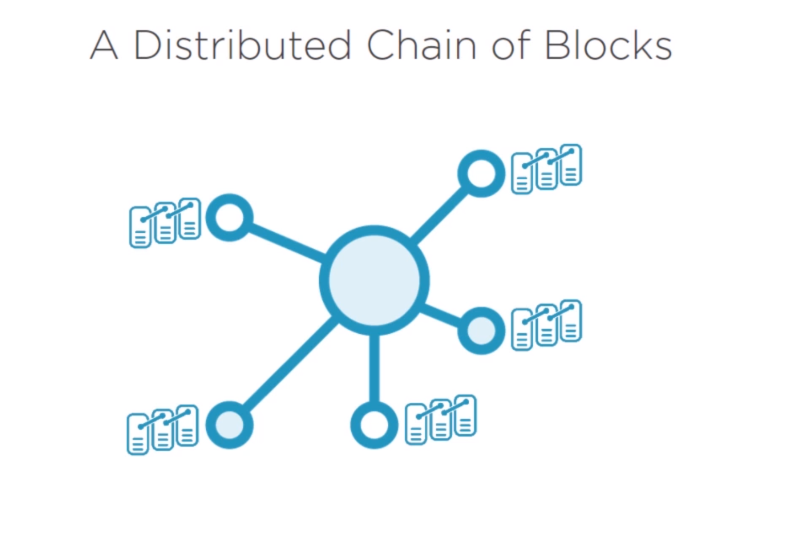

Slide 23
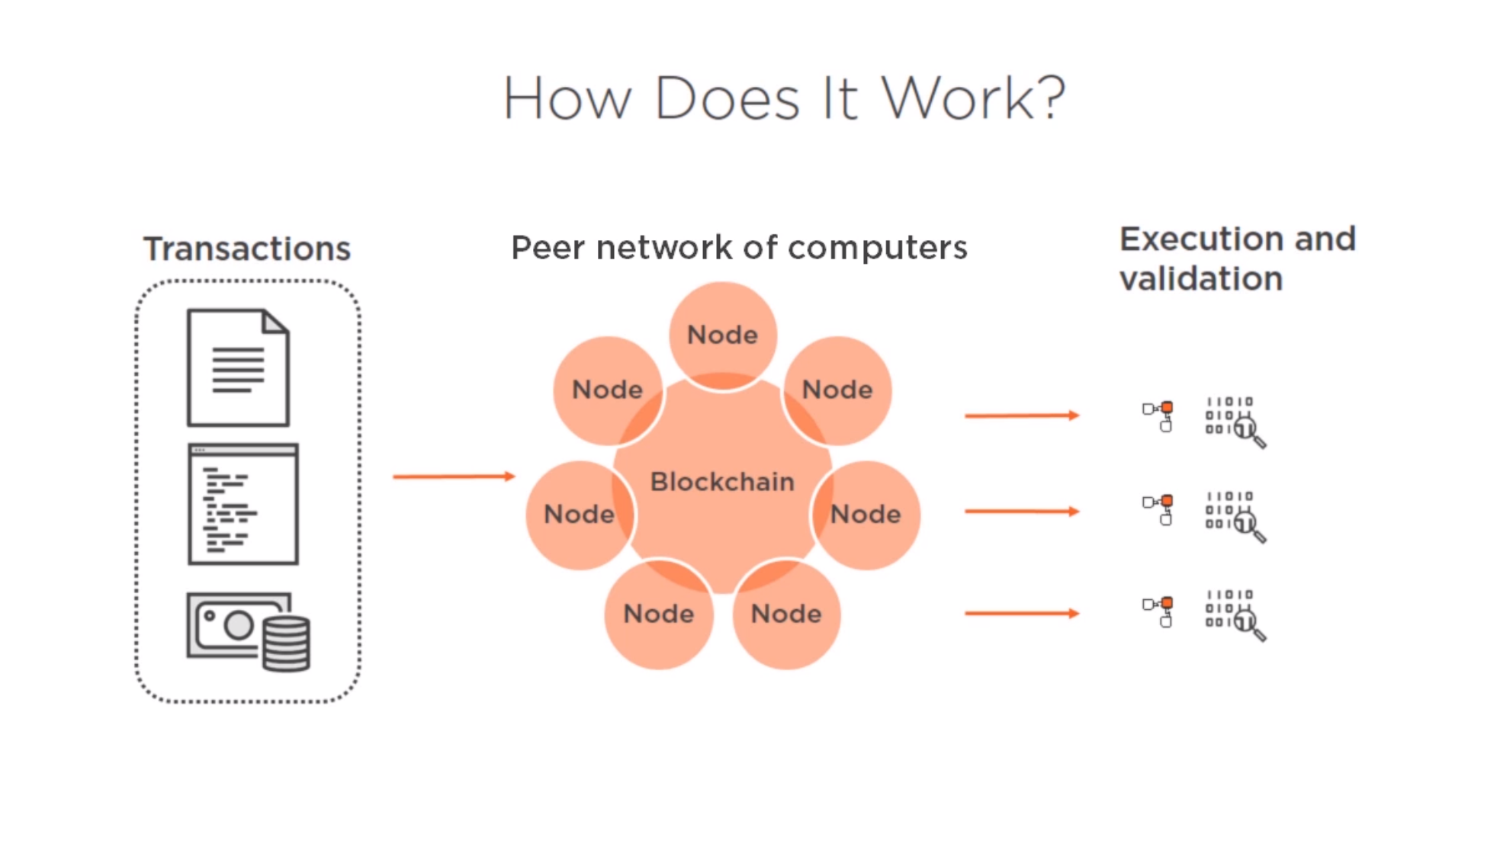

Slide 24
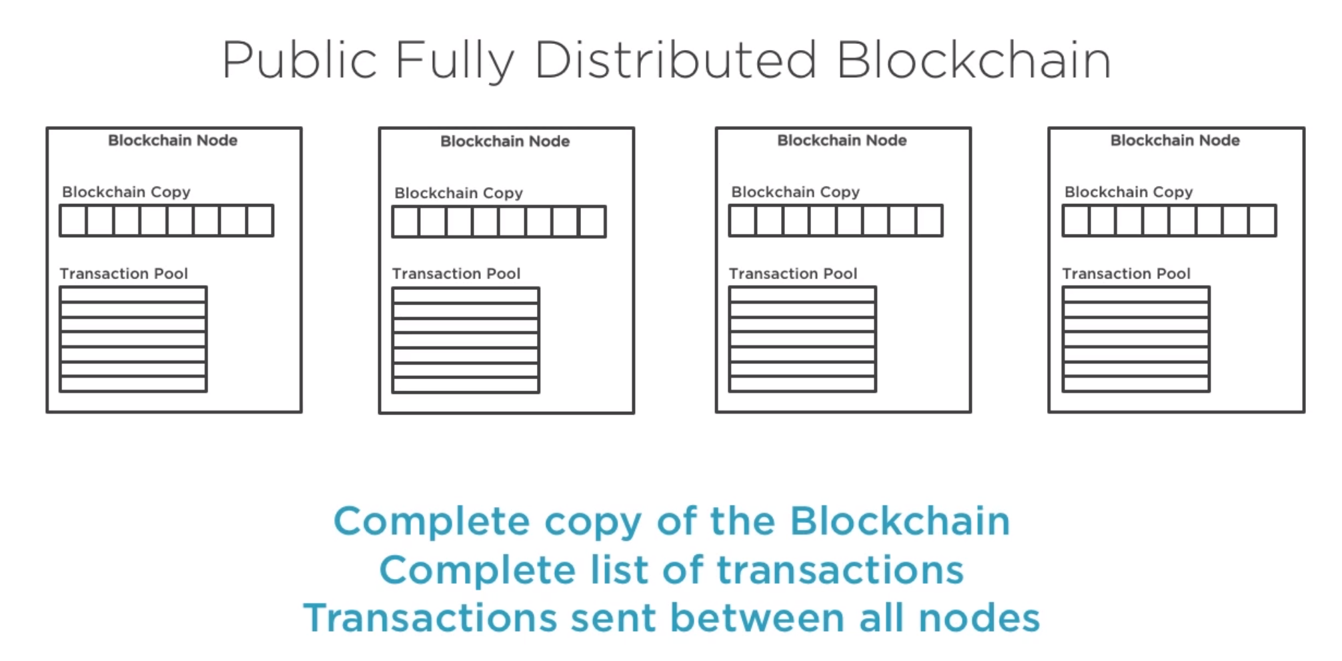

Slide 25
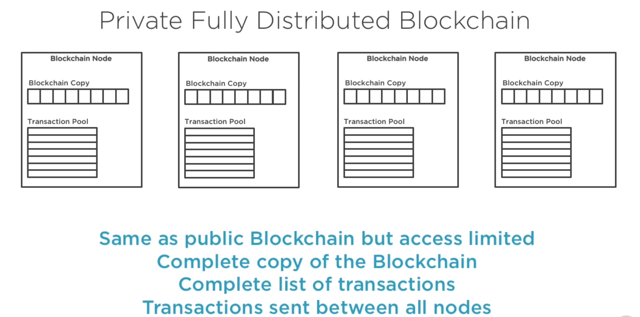

Slide 26
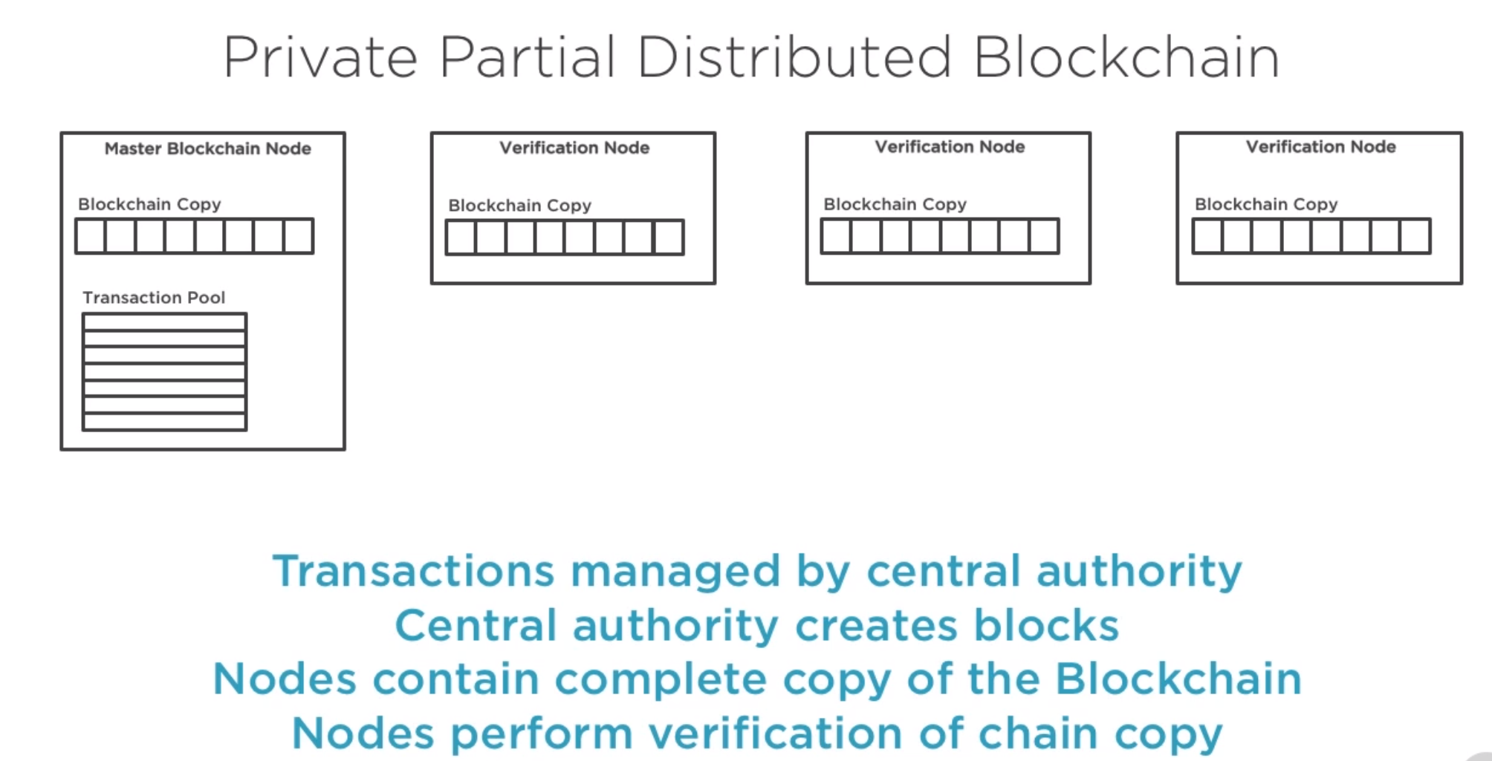
(aka Sidechains & Shadows)

Slide 27
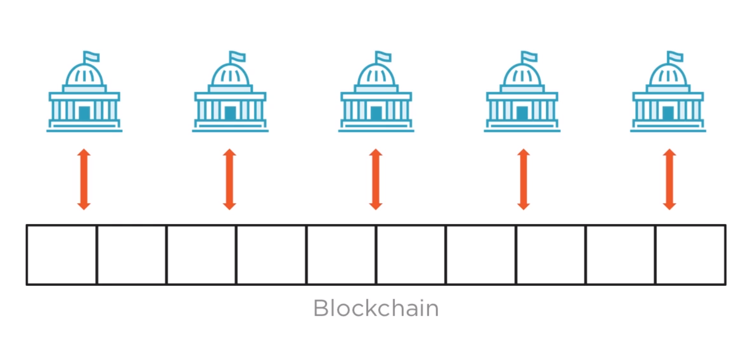
CONSORTIUMS

Slide 28
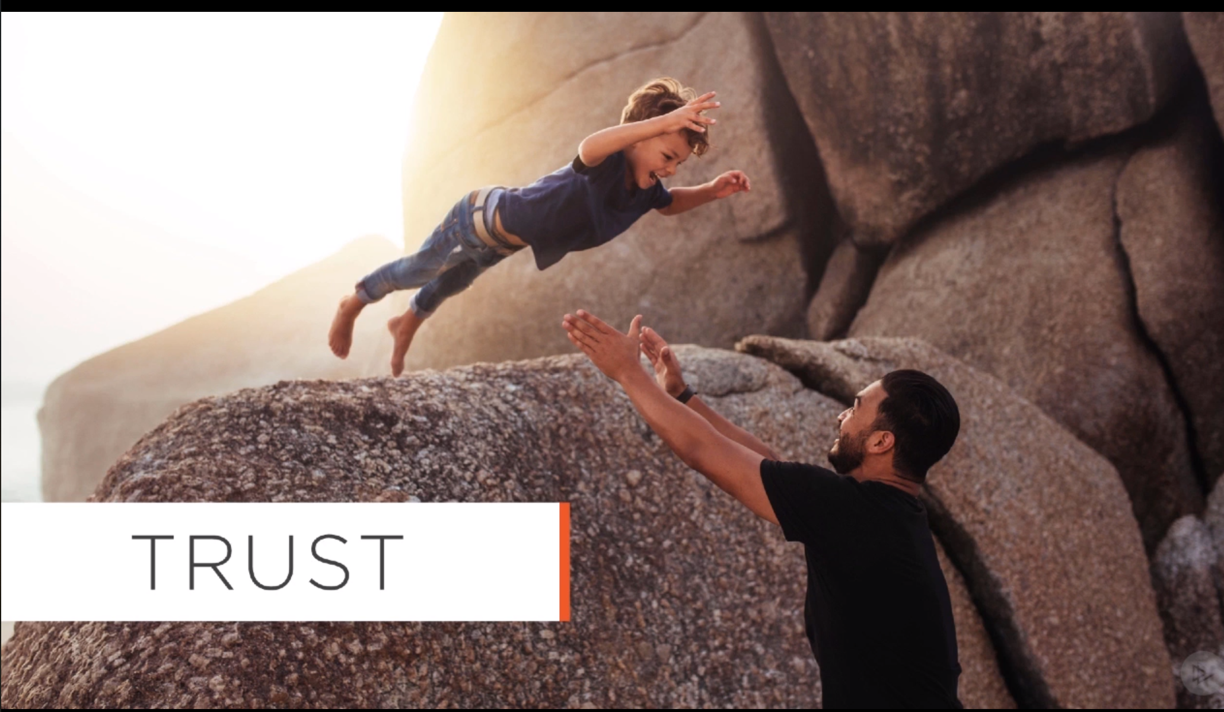

Slide 29
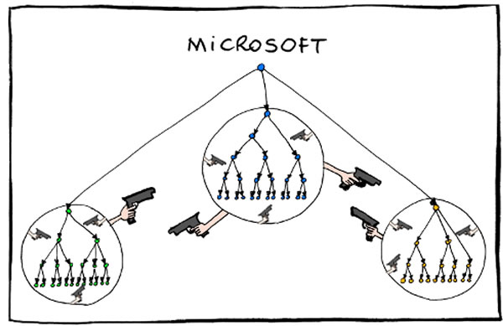

Slide 30
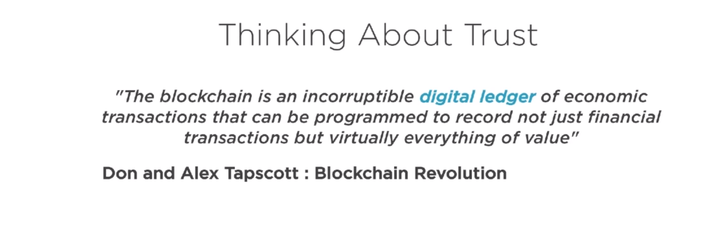

Slide 31
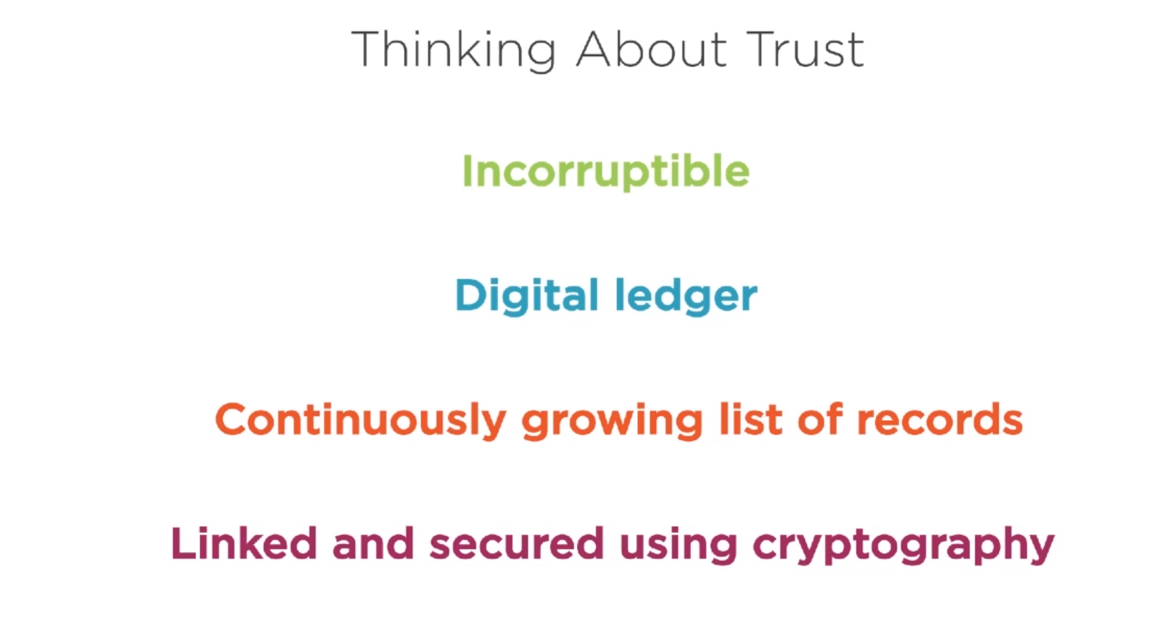

Slide 32
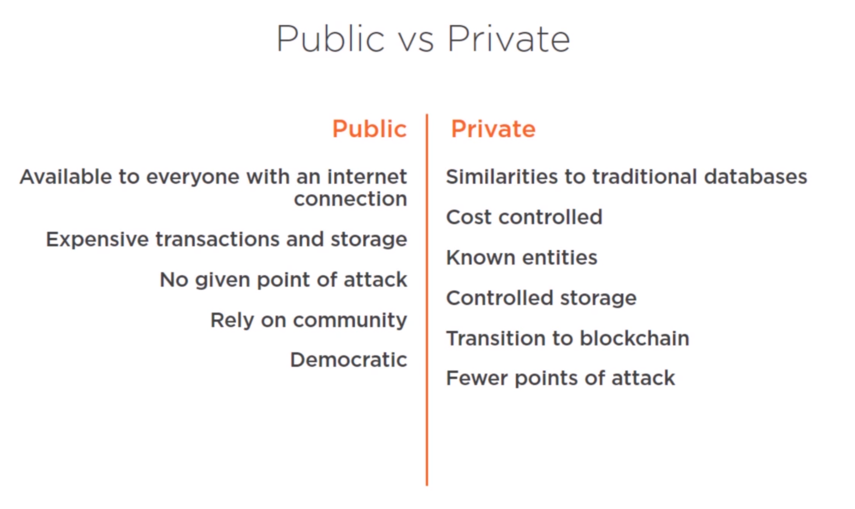

Slide 33
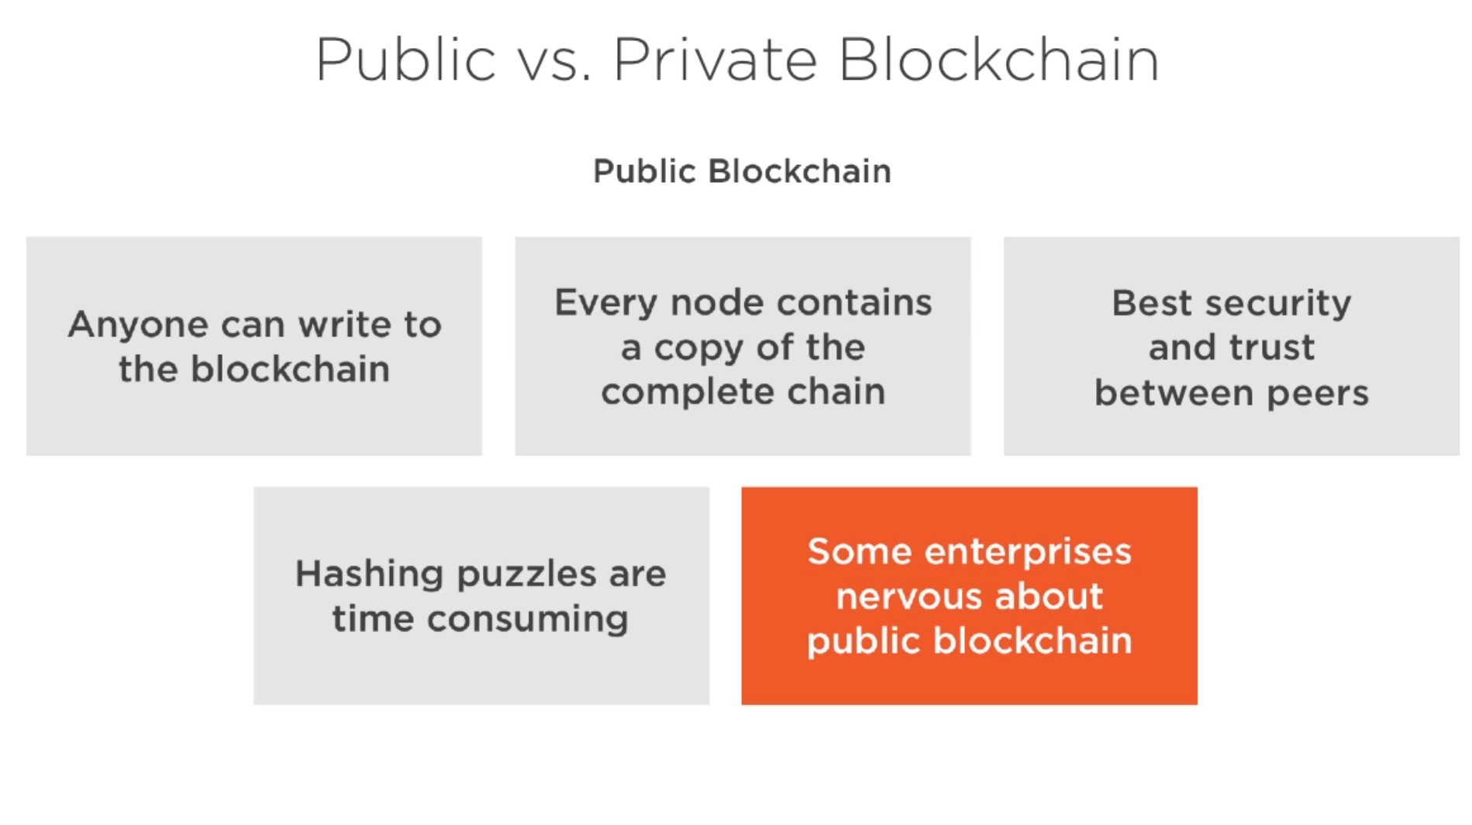

Slide 34
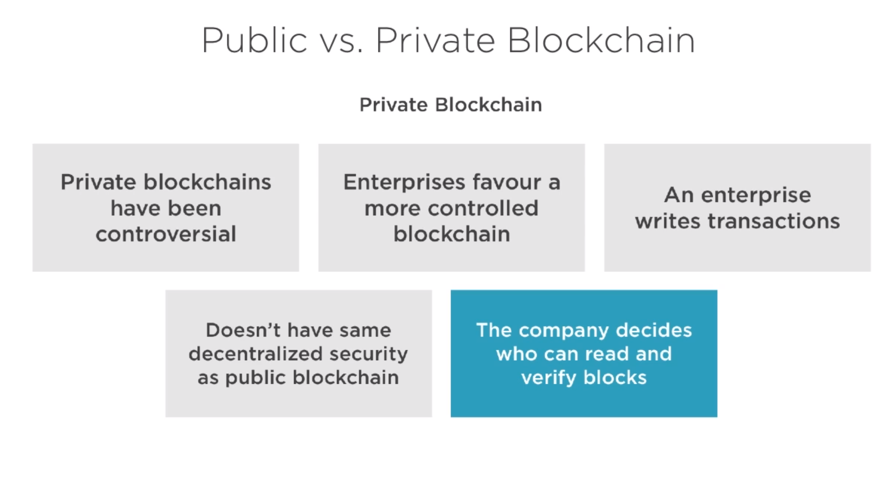

Slide 35
PROGRAMMING ON A BLOCKCHAIN

Slide 36
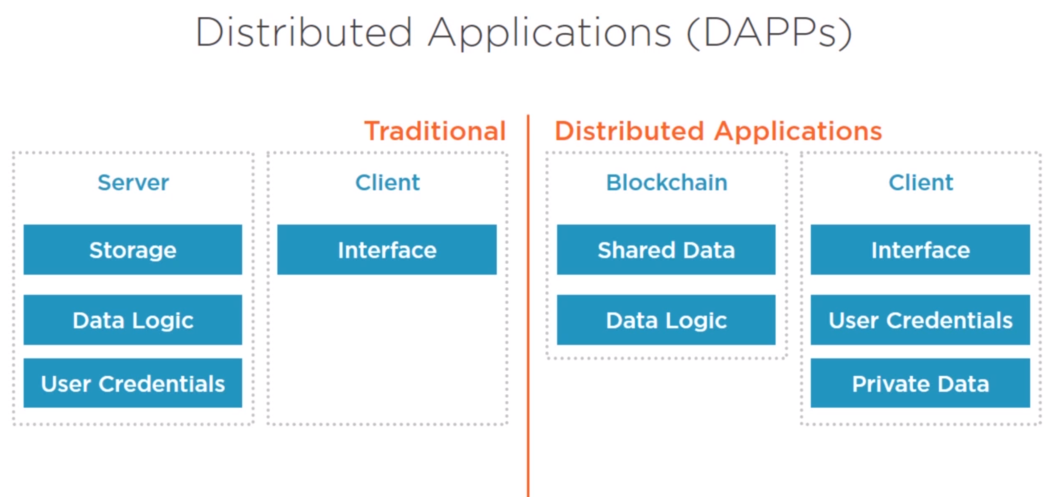

Slide 37
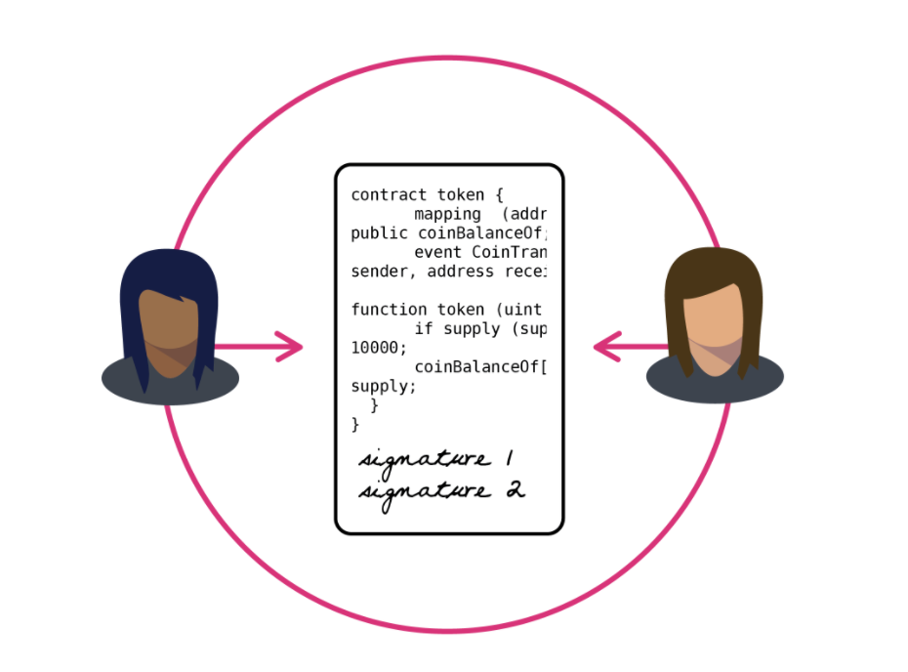
EVERY DAPP EXPOSES 1 OR MORE CONTRACTS

Slide 38
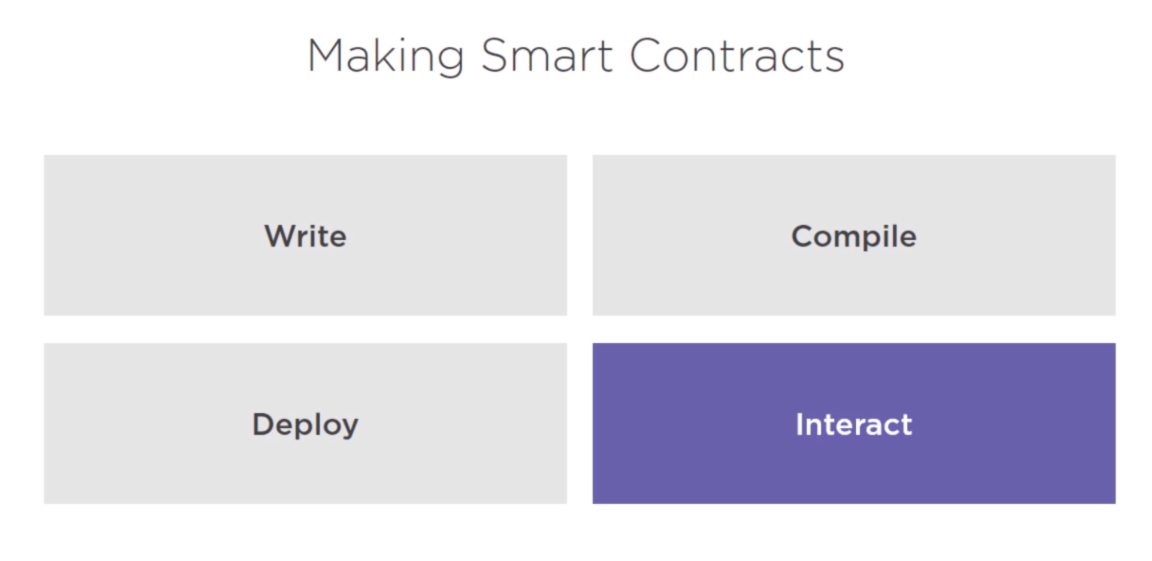

Slide 39
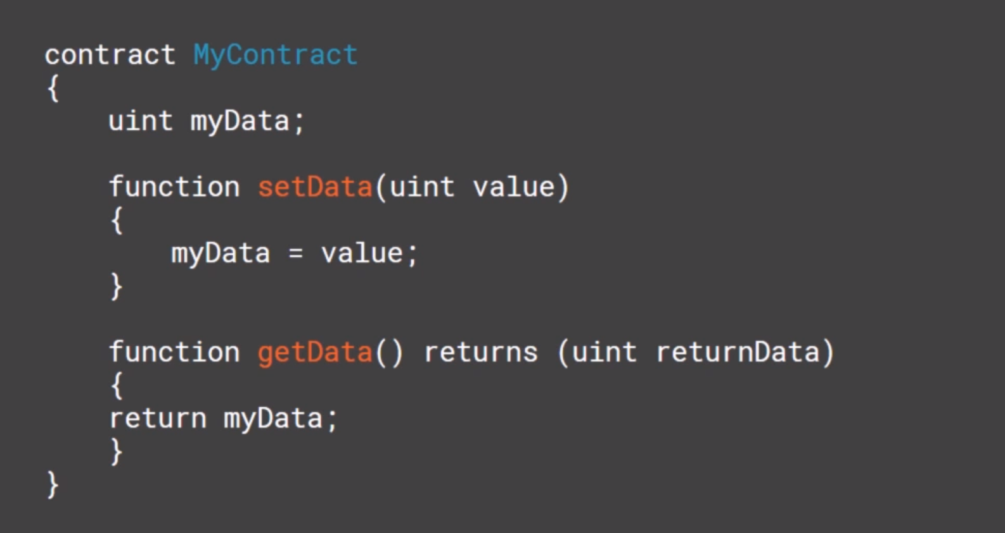

Slide 40
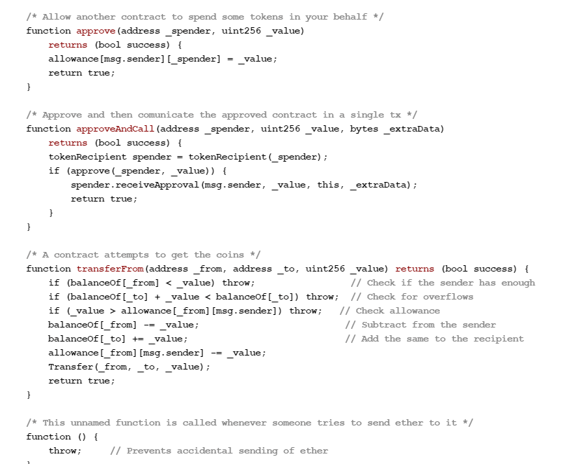

Slide 41
PUBLISHING SMART CONTRACTS
DAPPS run inside sandboxed execution engines
When a new smart contract or a transaction invoking a smart contract is distributed across the network as part of a block…
Each node that receives the block runs the smart contract during the consensus building process.
If a smart contract is found to be invalid (non-deterministic for example), the smart contract is not deployed.
Code is publicly viewable by anyone

Slide 42
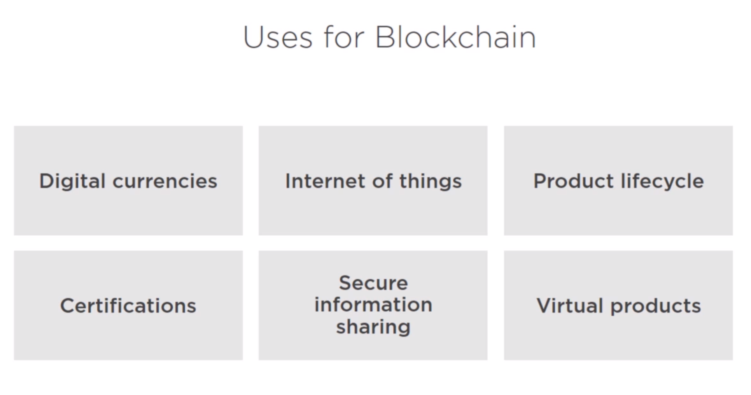

Slide 43
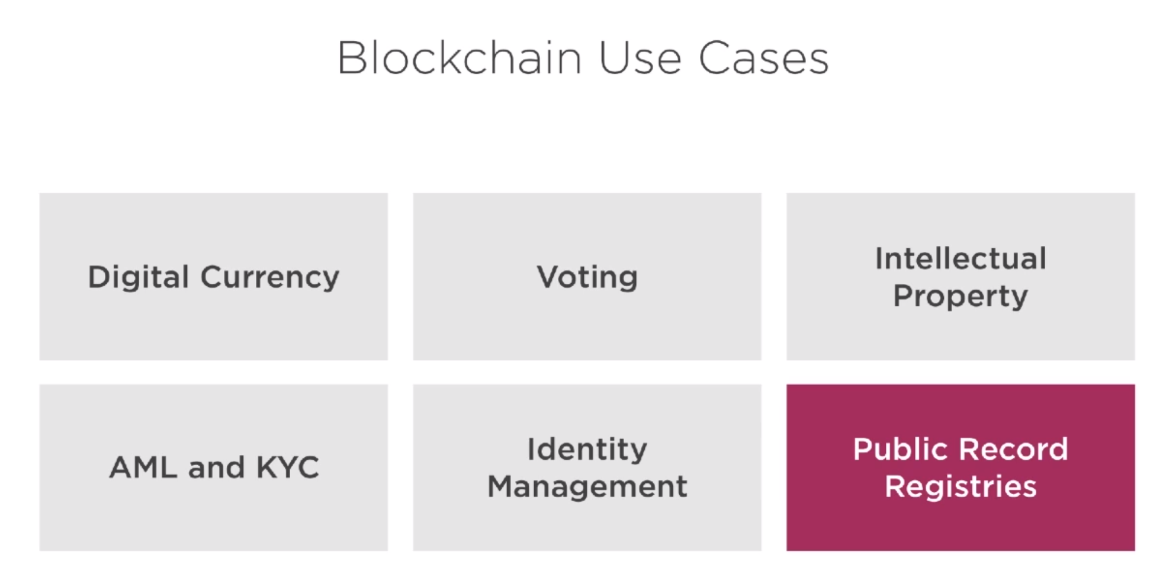
Notes:
AML = Anti-Money Laundering
KYC = Know Your Customer
Auctions
Games

Slide 44
DEMO: WHO ARE THE BIG PLAYERS?
Notes:
https://coinmarketcap.com/
https://blockexplorer.com/
https://www.ethereum.org/
https://www.eos.io/
https://www.hyperledger.org/
https://stratisplatform.com/
https://www.coindesk.com/walmart-blockchain-food-tracking-test-results-encouraging

Slide 45
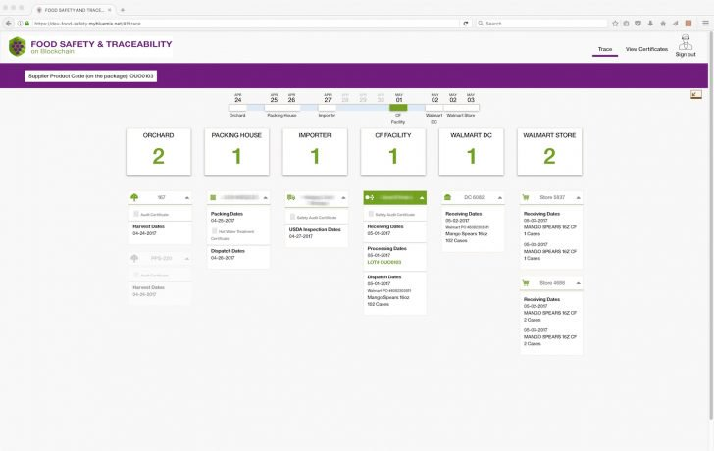
CASE STUDY: WALMART FOOD NET
https://www.coindesk.com/walmart-blockchain-food-tracking-test-results-encouraging/
Notes:
Good video on this page:
http://fortune.com/2017/08/22/walmart-blockchain-ibm-food-nestle-unilever-tyson-dole/

Slide 46
WHAT IS BLOCKCHAIN?
A replacement currency that will take over the world?
The next big internet boom?
A computer science solution looking for a problem?
A practical solution to some real world problems

Slide 47
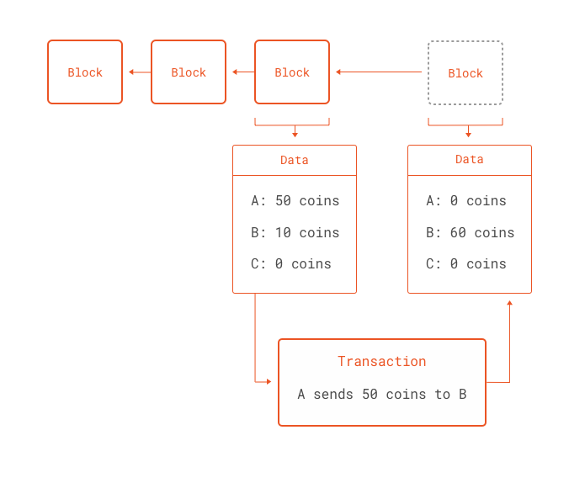

Slide 48
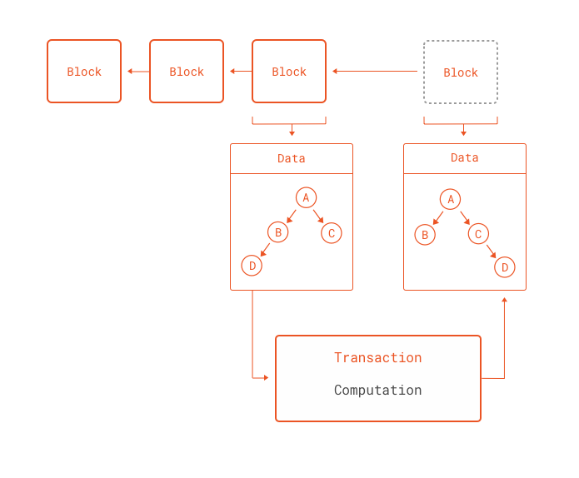

Slide 49
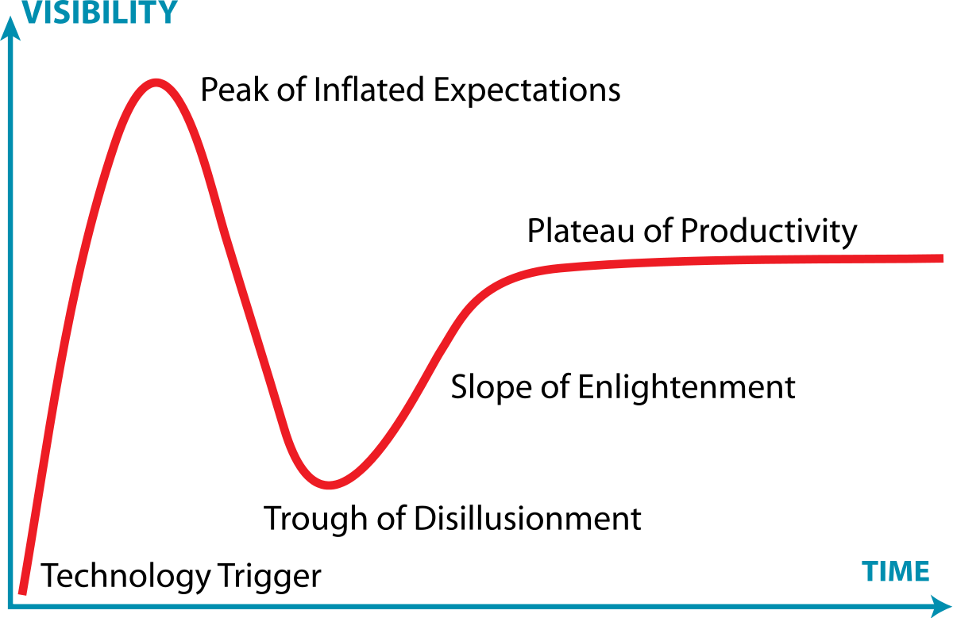

Slide 50
Q & A

Slide 51
Clint Edmonson
Polaris Solutions
clinted@polarissolutions.com

Slide 52
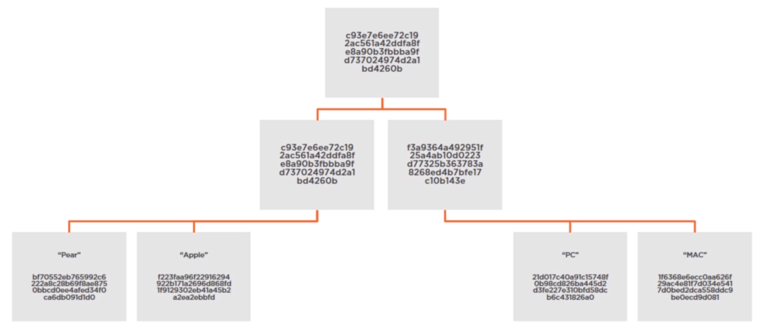
MERKLE TREE

Slide 53
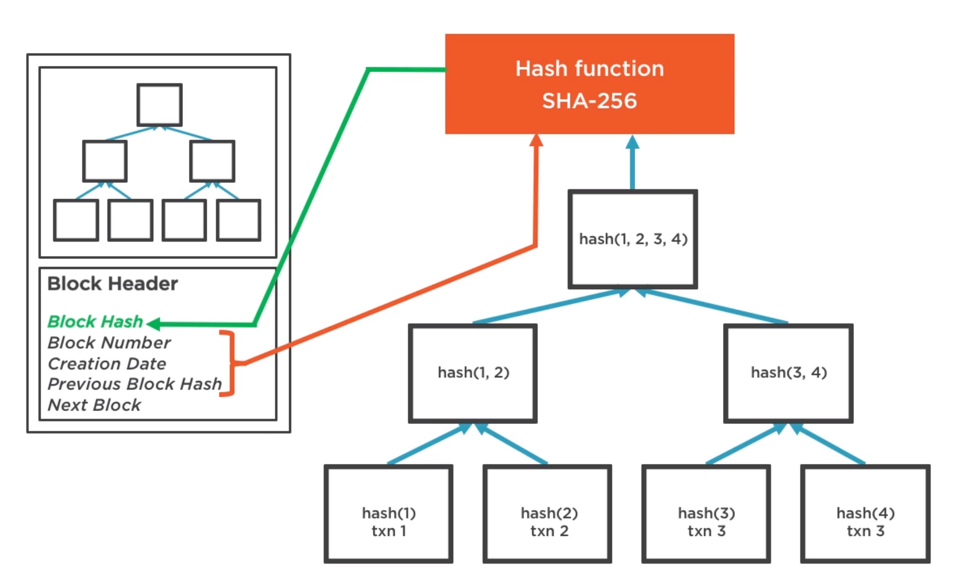

Slide 54
WHAT IS A BLOCKCHAIN?

Slide 55
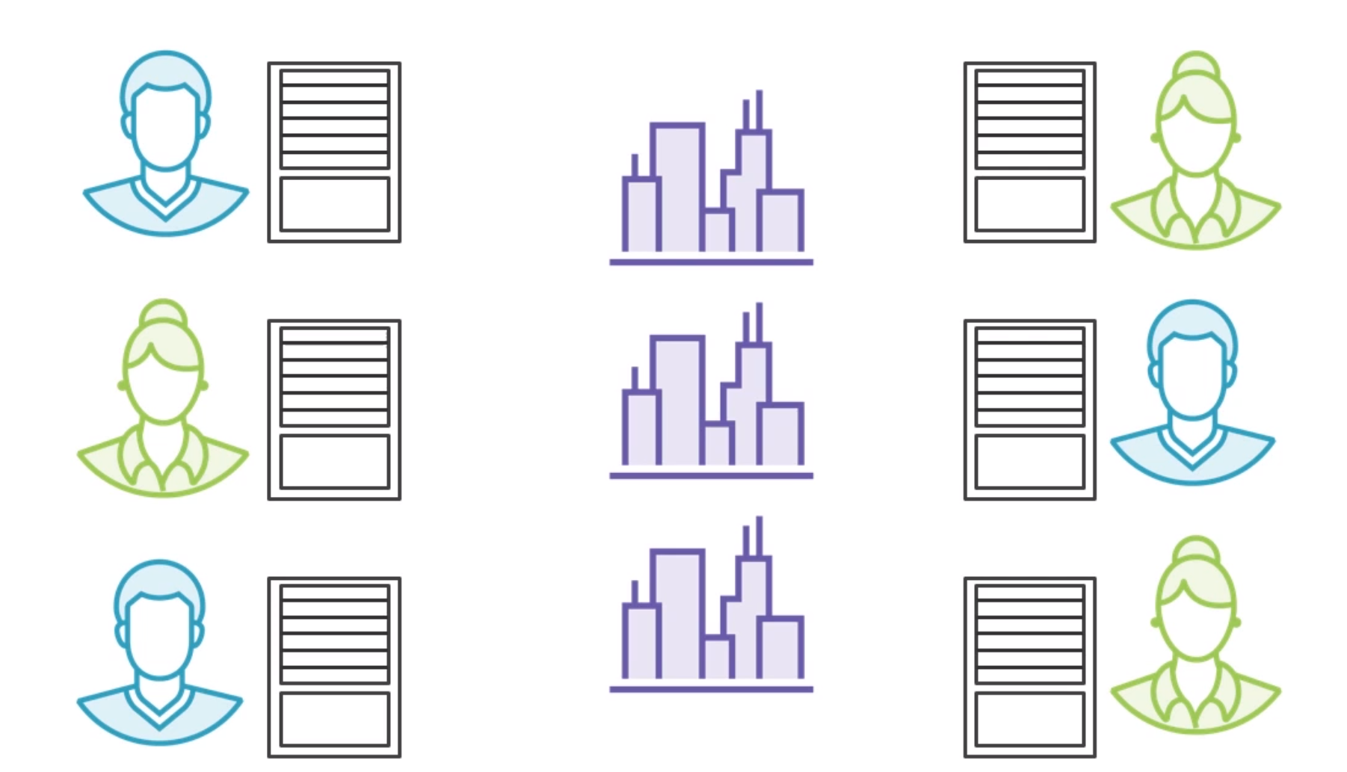

Slide 56
TOPICS
Hashing
Storing transactions in blocks
Storing blocks in chains
Public vs Private Blockchain
Consensus
Verify blocks created by others
Generate blocks using agreed upon contracts & algorithms
Trust
DAPPS
Smart Contracts
Implementations
Bitcoin
Ethereum
EOS
IBM Bluemix
Use Cases
Case Studies
Bitcoin
FoodNet
Proof of work / Proof of stake
Nonce???

Slide 57
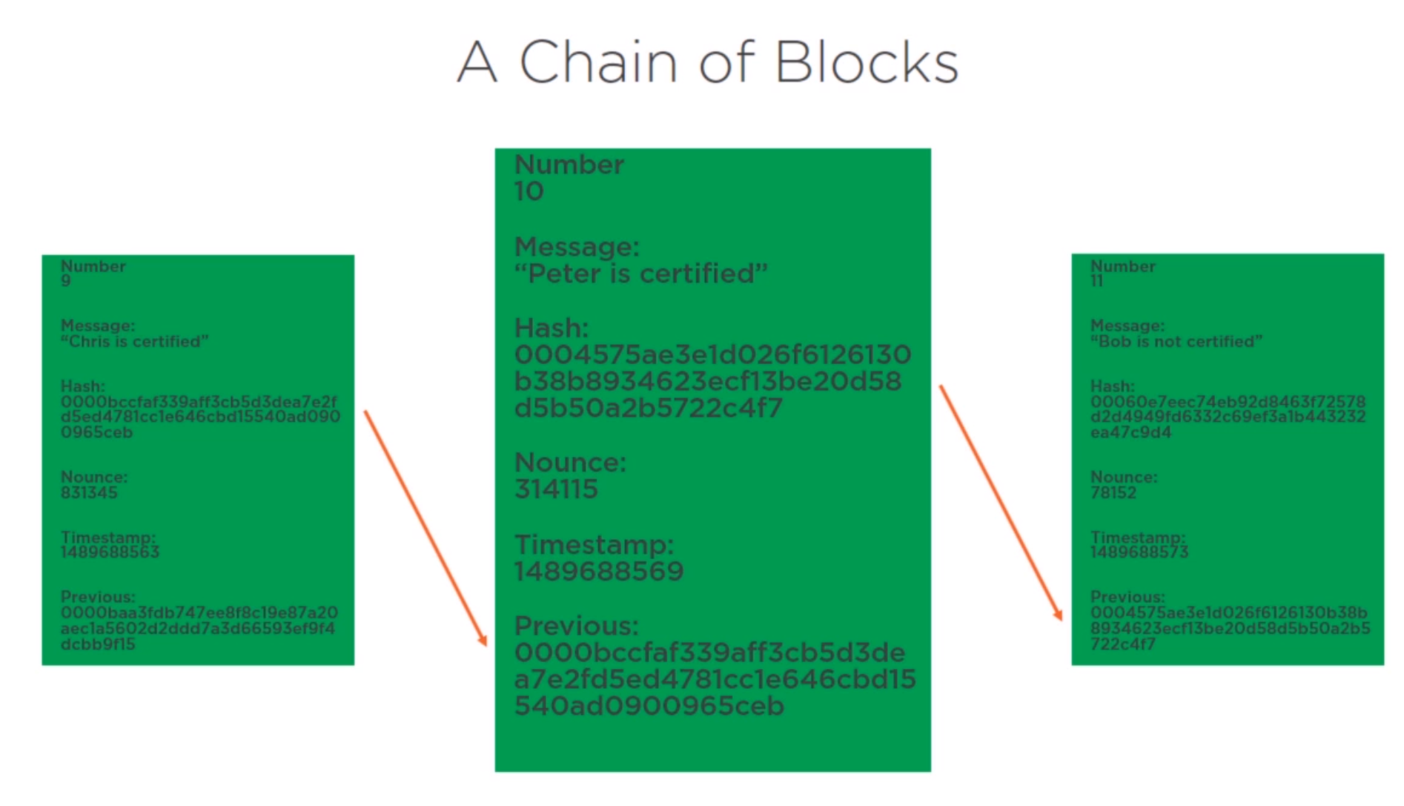

Slide 58
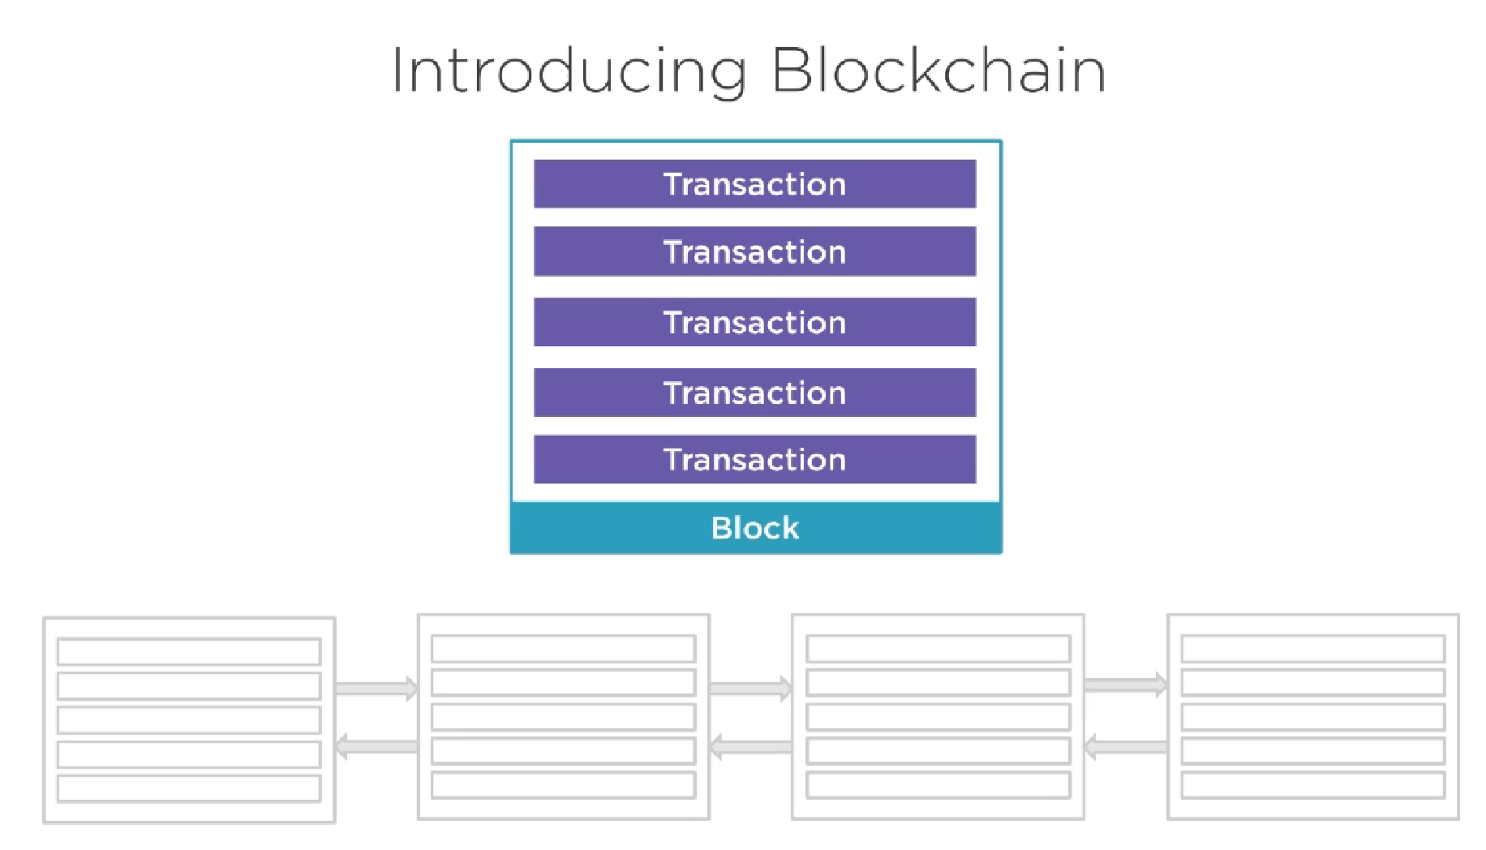

Slide 59
